Slide 1

Unit 3
Unit–III
Software Design: Overview of the design process, How to characterize a good software design? Layered arrangement of modules, Cohesion and Coupling, approaches to software design.
Agility: Agility and the Cost of Change, Agile Process, Extreme Programming (XP), Other Agile Process Models, Tool Set for the Agile Process (Text Book 2)
Function-Oriented Software Design: Overview of SA/SD methodology, Structured analysis, Developing the DFD model of a system, Structured design, Detailed design, and Design Review.
User Interface Design: Characteristics of a good user interface, Basic concepts, Types of user interfaces, Fundamentals of component-based GUI development, and user interface design methodology

Slide 2
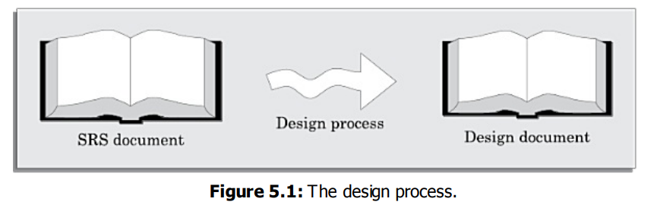
Overview of the design process
The design process essentially transforms the SRS document into a design document.
Outcome of the Design Process
Classification of Design Activities
Classification of Design Methodologies

Slide 3
Overview of the design process
Outcome of the Design Process
Different modules required: The different modules in the solution should be clearly identified. Each module is a collection of functions and the data shared by the functions of the module.
Control relationships among modules: A control relationship between two modules essentially arises due to function calls across the two modules.
Interfaces among different modules: The interfaces between two modules identifies the exact data items that are exchanged between the two modules when one module invokes a function of the other module.
Data structures of the individual modules: Each module normally stores some data that the functions of the module need to share to accomplish the overall responsibility of the module.
Algorithms required to implement the individual modules: The algorithms required to accomplish the processing activities of various modules need to be carefully designed and documented

Slide 4
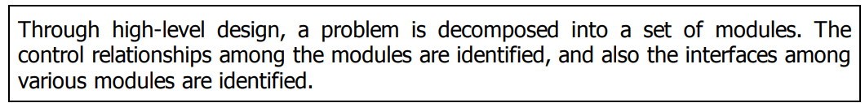
Overview of the design process
2. Classification of Design Activities
• Preliminary (or high-level) design, and
• Detailed design

Slide 5
Overview of the design process
3. Classification of Design Methodologies
We can roughly classify these methodologies into procedural and object-oriented approaches.
A procedural approach focuses on breaking down a problem into a series of step-by-step instructions, essentially following a linear path to execute functions,
while an object-oriented approach centers around creating "objects" which encapsulate data and actions (methods) within them, allowing for more modular and reusable code by modeling real-world entities and their interactions

Slide 6
HOW TO CHARACTERISE A GOOD SOFTWARE DESIGN?
Correctness: A good design should first of all be correct. That is, it should
correctly implement all the functionalities of the system.
Understandability: A good design should be easily understandable. Unless
a design solution is easily understandable, it would be difficult to implement
and maintain it.
Efficiency: A good design solution should adequately address resource,
time, and cost optimization issues.
Maintainability: A good design should be easy to change. This is an important requirement, since change requests usually keep coming from the customer even after product release

Slide 7
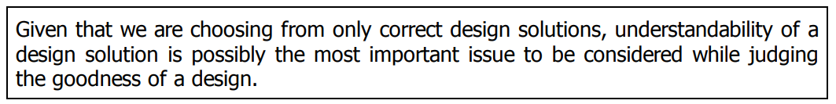
HOW TO CHARACTERISE A GOOD SOFTWARE DESIGN? : Understandability of a Design: A Major Concern
A design solution should have the following characteristics to be easily understandable:
It should assign consistent and meaningful names to various design components.
It should make use of the principles of decomposition and abstraction in good measures to simplify the design.

Slide 8
HOW TO CHARACTERISE A GOOD SOFTWARE DESIGN? : Modularity
A modular design is an effective decomposition of a problem. It is a basic characteristic of any good design solution.
A modular design, in simple words, implies that the problem has been decomposed into a set of modules that have only limited interactions with each other.

Slide 9
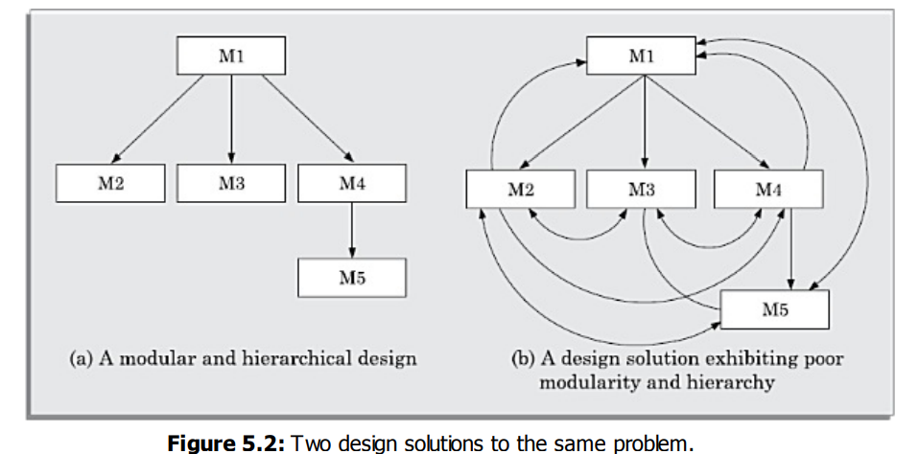
HOW TO CHARACTERISE A GOOD SOFTWARE DESIGN? : Modularity

Slide 10
COHESION AND COUPLING
Cohesion is a measure of the functional strength of a module, whereas the coupling between two modules is a measure of the degree of interaction (or interdependence) between the two modules.

Slide 11
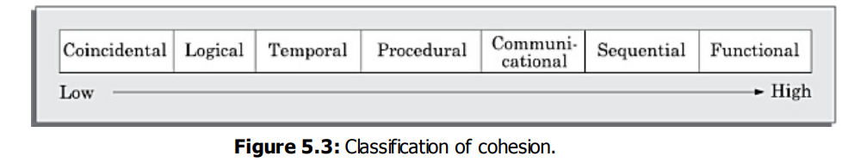
COHESION AND COUPLING
Classification of Cohesiveness
Cohesiveness of a module is the degree to which the different functions of the module co-operate to work towards a single objective. The different modules of a design can possess different degrees of freedom

Slide 12
COHESION AND COUPLING
Coincidental cohesion: A module is said to have coincidental cohesion, if it performs a set of tasks that relate to each other very loosely, if at all.
Logical cohesion: A module is said to be logically cohesive, if all elements of the module perform similar operations, such as data input, data output.
Temporal cohesion: When a module contains functions that are related by the fact that these functions are executed in the same time span, then the module is said to possess temporal cohesion.
Procedural cohesion: A module is said to possess procedural cohesion, if the set of functions of the module are executed one after the other
Communicational cohesion: A module is said to have communicational cohesion, if all functions of the module refer to or update the same data structure.

Slide 13
COHESION AND COUPLING
Sequential cohesion: A module is said to possess sequential cohesion, if the different functions of the module execute in a sequence, and the output from one function is input to the next in the sequence.
Functional cohesion: A module is said to possess functional cohesion, if different functions of the module co-operate to complete a single task.

Slide 14
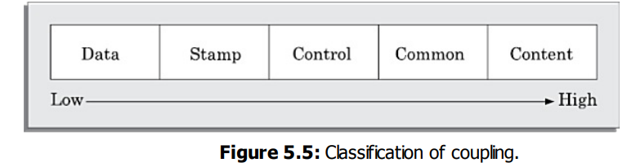
COHESION AND COUPLING
Classification of Coupling
The coupling between two modules indicates the degree of interdependence between them

Slide 15
COHESION AND COUPLING
Data coupling: Two modules are data coupled, if they communicate using an elementary data item that is passed as a parameter e.g. an integer, a float, a character, etc.
Stamp coupling: Two modules are stamp coupled, if they communicate using a composite data item such as a record in PASCAL or a structure in C
Control coupling: Control coupling exists between two modules, if data from one module is used to direct the order of instruction execution in another.
Common coupling: Two modules are common coupled, if they share some global data items.
Content coupling: Content coupling exists between two modules, if they share code

Slide 16
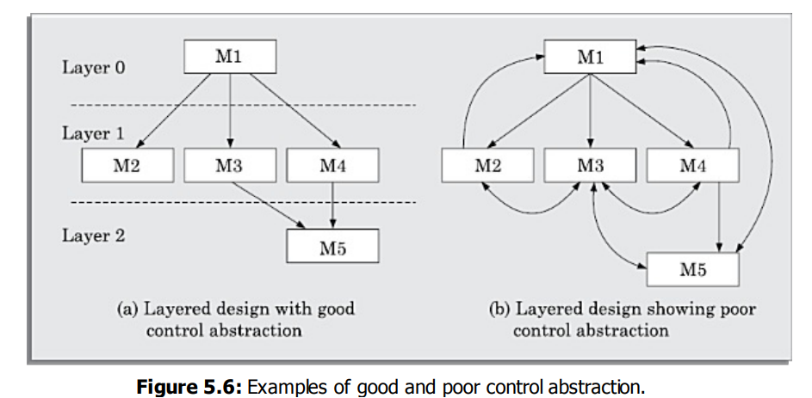
LAYERED ARRANGEMENT OF MODULES
The control hierarchy represents the organization of program components in terms of their call relationships.
Thus, we can say that the control hierarchy of a design is determined by the order in which different modules call each other.

Slide 17
LAYERED ARRANGEMENT OF MODULES
Superordinate and subordinate modules: In a control hierarchy, a module that controls another module is said to be superordinate to it. Conversely, a module controlled by another module is said to be subordinate to the controller
Visibility: A module B is said to be visible to another module A, if A directly calls B. Thus, only the immediately lower layer modules are said to be visible to a module.

Slide 18
LAYERED ARRANGEMENT OF MODULES
Depth and width: Depth and width of a control hierarchy provide an indication of the number of layers and the overall span of control respectively. For the design of Figure 5.6(a), the depth is 3 and width is also 3
Fan-out: Fan-out is a measure of the number of modules that are directly controlled by a given module. In Figure 5.6(a), the fan-out of the module M1 is 3.
Fan-in:High fan-in represents code
reuse and is in general, desirable
in a good design. In Figure 5.6(a),
the fan-in of the module M1 is 0,
that of M2 is 1, and that of M5 is 2

Slide 19
APPROACHES TO SOFTWARE DESIGN
There are two fundamentally different approaches to software design that are in use today— function-oriented design, and object-oriented design.
Function-oriented Design
The following are the salient features of the function-oriented design approach:
Top-down decomposition: In top-down decomposition, starting at a high-level view of the system, each high-level function is successively refined into more detailed functions.
Centralised system state: The system state can be defined as the values of certain data items that determine the response of the system to a user action or external event.

Slide 20
APPROACHES TO SOFTWARE DESIGN
Object-oriented Design
In the object-oriented design (OOD) approach, a system is viewed as being made up of a collection of objects (i.e. entities). Each object is associated with a set of functions that are called its methods.
Data abstraction: The principle of data abstraction implies that how data is exactly stored is abstracted away.
Data structure: A data structure is constructed from a collection of primitive data items
Data type: A type is a programming language terminology that refers to anything that can be instantiated.

Slide 21
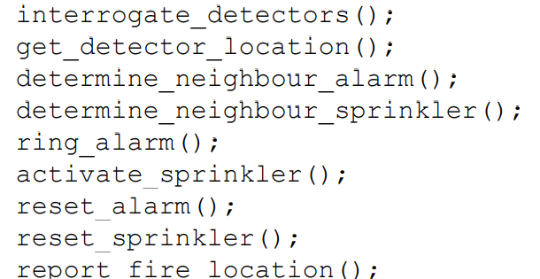
Automated fire-alarm system—customer requirements
Function-oriented approach
The functions which operate on the system state are:

Slide 22
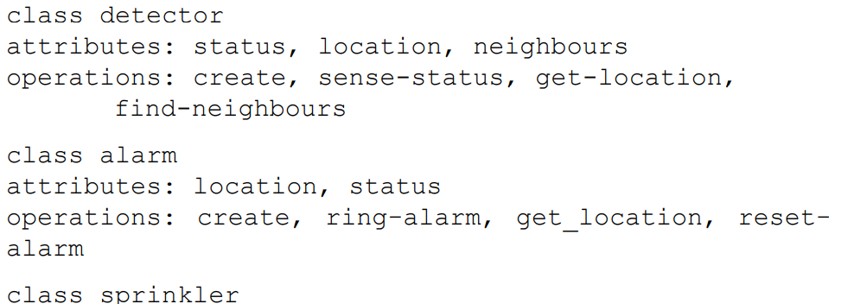
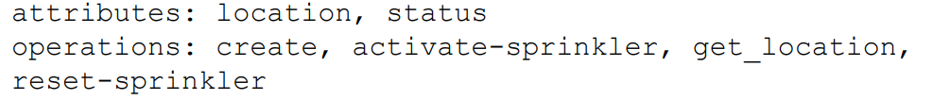
Automated fire-alarm system—customer requirements
Object-oriented approach: In the object-oriented approach, the different classes of objects are identified. Subsequently, the methods and data for each object are identified. Finally, an appropriate number of instances of each class is created.

Slide 23
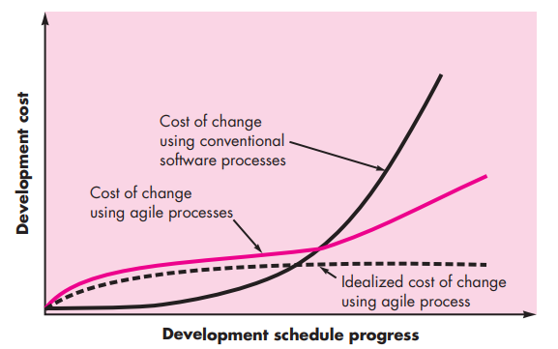
Agility and the Cost of Change
Agility – Todays buzz word – means Quick respond to changes

Slide 24
Agility Process
Agility Principles
Human Factors
Agility Principles
The Agile Alliance defines 12 agility principles for those who want to achieve agility
Our highest priority is to satisfy the customer through early and continuous delivery of valuable software.
Welcome changing requirements, even late in development. Agile processes harness change for the customer’s competitive advantage.
Deliver working software frequently, from a couple of weeks to a couple of months, with a preference to the shorter timescale.

Slide 25
Agility Process
1. Agility Principles
4. Business people and developers must work together daily throughout the project.
5. Build projects around motivated individuals. Give them the environment and support they need, and trust them to get the job done.
6. The most efficient and effective method of conveying information to and within a development team is face-to-face conversation.
7. Working software is the primary measure of progress.
8. Agile processes promote sustainable development. The sponsors, developers, and users should be able to maintain a constant pace indefinitely

Slide 26
Agility Process
1. Agility Principles
9. Continuous attention to technical excellence and good design enhances agility.
10. Simplicity—the art of maximizing the amount of work not done—is essential.
11. The best architectures, requirements, and designs emerge from self– organizing teams.
12. At regular intervals, the team reflects on how to become more effective, then tunes and adjusts its behavior accordingly

Slide 27
Agility Process
2. Human Factors
Proponents of agile software development take great pains to emphasize the importance of “people factors.”
If members of the software team are to drive the characteristics of the process that is applied to build software, a number of key traits must exist among the people on an agile team and the team itself.
Competence. In an agile development (as well as software engineering) context, “competence” encompasses innate talent, specific software-related skills, and overall knowledge of the process that the team has chosen to apply.
Common focus. Although members of the agile team may perform different tasks and bring different skills to the project, all should be focused on one goal—to deliver a working software increment to the customer within the time promised.

Slide 28
Agility Process
Collaboration. Software engineering (regardless of process) is about assessing, analyzing, and using information that is communicated to the software team.
Decision-making ability. Any good software team (including agile teams) must be allowed the freedom to control its own destiny.
Fuzzy problem-solving ability. Software managers must recognize that the agile team will continually have to deal with ambiguity and will continually be buffeted by change.
Mutual trust and respect. The agile team must become a “jelled” team. A jelled team exhibits the trust and respect that are necessary to make them “so strongly knit that the whole is greater than the sum of the parts”

Slide 29
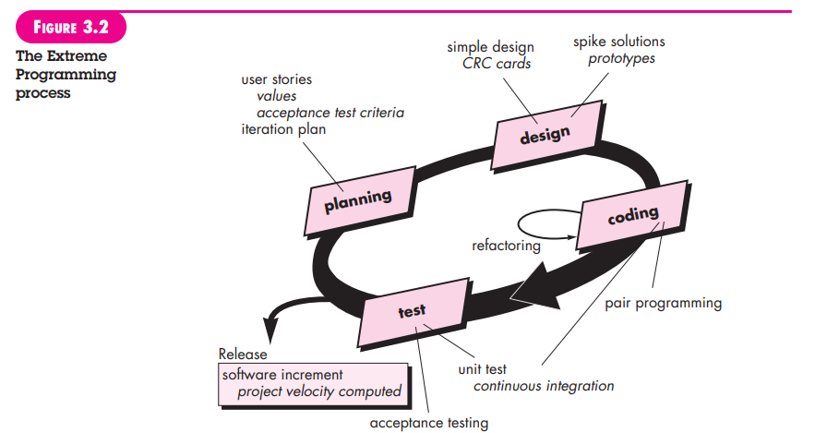
Extreme Programming (XP)

Slide 30
OTHER AGILE PROCESS MODELS
• Adaptive Software Development (ASD)
• Scrum
• Dynamic Systems Development Method (DSDM)
• Crystal
• Feature Drive Development (FDD)
• Lean Software Development (LSD)
• Agile Modeling (AM)
• Agile Unified Process (AUP)

Slide 31
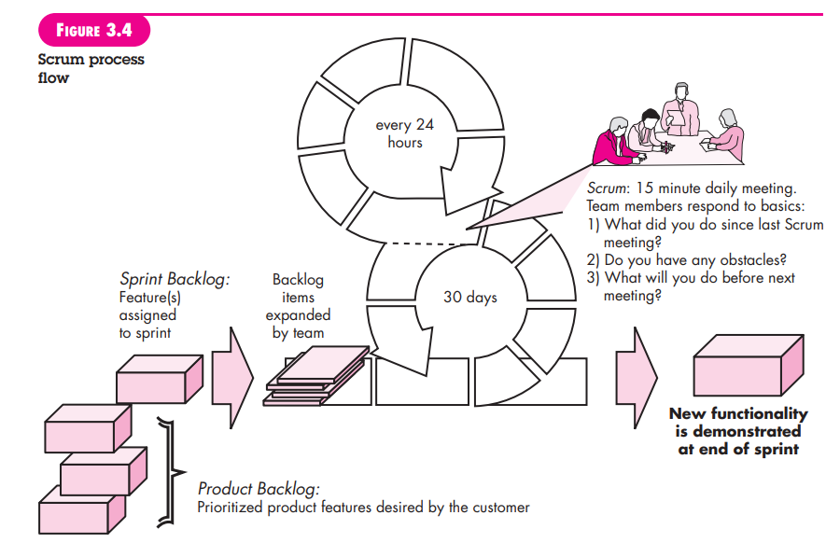
SCRUM

Slide 32
A TOOL SET FOR THE AGILE PROCESS
Agile alliance suggests some tools can have a benefit and that “agile teams stress using tools that permit the rapid flow of understanding
Hiring tools - right people (hiring), team collaboration, stakeholder communication
Collaborative and communication tools - Active communication, Pair Programming
Project management tools - nurturing social interactions, graphs of tests created versus passed

Slide 33
FUNCTION-ORIENTED SOFTWARE
DESIGN
The SA/SD technique can be used to perform the high-level design of a software.
OVERVIEW OF SA/SD METHODOLOGY
As the name itself implies, SA/SD methodology involves carrying out two distinct activities:
Structured analysis (SA)
Structured design (SD)
During structured analysis, the SRS document is transformed into a data flow diagram (DFD) model.
During structured design, the DFD model is transformed into a structure chart.

Slide 34
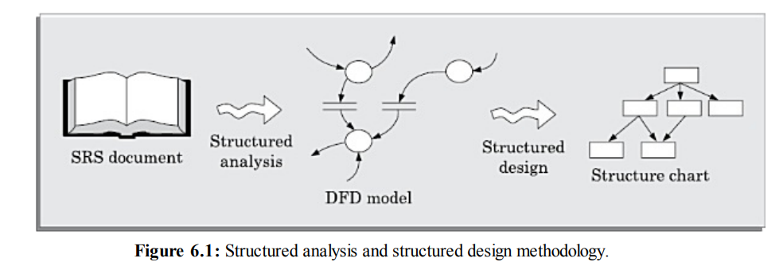
FUNCTION-ORIENTED SOFTWARE
DESIGN

Slide 35
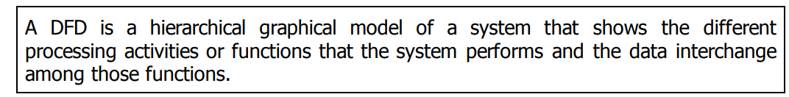
FUNCTION-ORIENTED SOFTWARE
DESIGN
STRUCTURED ANALYSIS
The structured analysis technique is based on the following underlying principles:
Top-down decomposition approach.
Application of divide and conquer principle. Through this each high-level function is independently decomposed into detailed functions.
Graphical representation of the analysis results using data flow diagrams (DFDs).

Slide 36
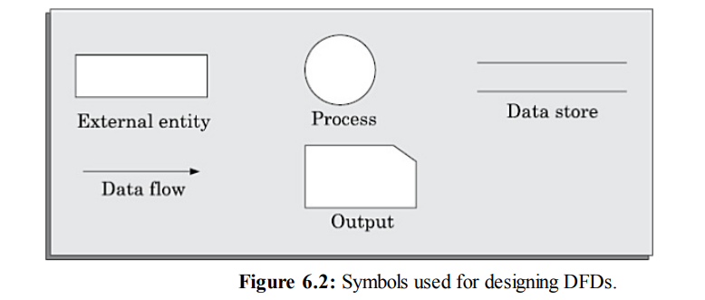
FUNCTION-ORIENTED SOFTWARE
DESIGN
Primitive symbols used for constructing DFDs
There are essentially five different types of symbols used for constructing DFDs. These primitive symbols are depicted in Figure 6.2. The meaning of these symbols are explained as follows:

Slide 37
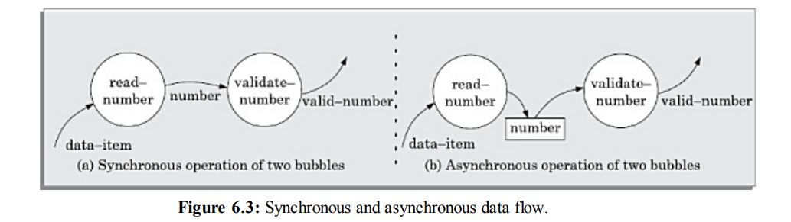
FUNCTION-ORIENTED SOFTWARE
DESIGN
Synchronous and asynchronous operations

Slide 38
FUNCTION-ORIENTED SOFTWARE
DESIGN
Synchronous and asynchronous operations

Slide 39
FUNCTION-ORIENTED SOFTWARE
DESIGN
Data dictionary
Every DFD model of a system must be accompanied by a data dictionary.
A data dictionary lists all data items that appear in a DFD model.

Slide 40
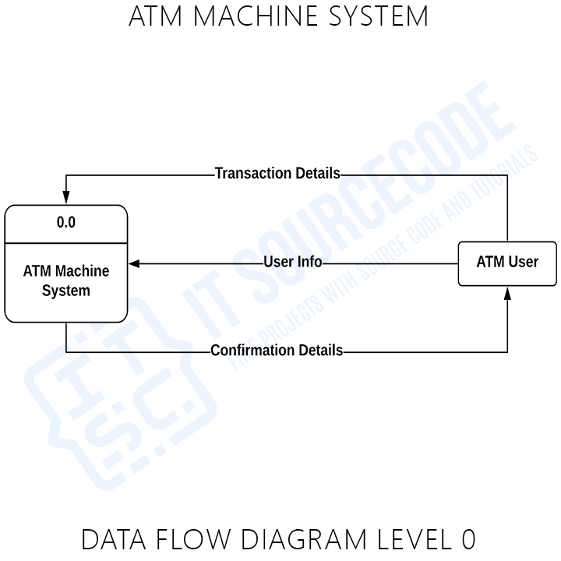
FUNCTION-ORIENTED SOFTWARE
DESIGN
Context Diagram
The context diagram is the most abstract (highest level) data flow representation of a system. It represents the entire system as a single bubble.

Slide 41
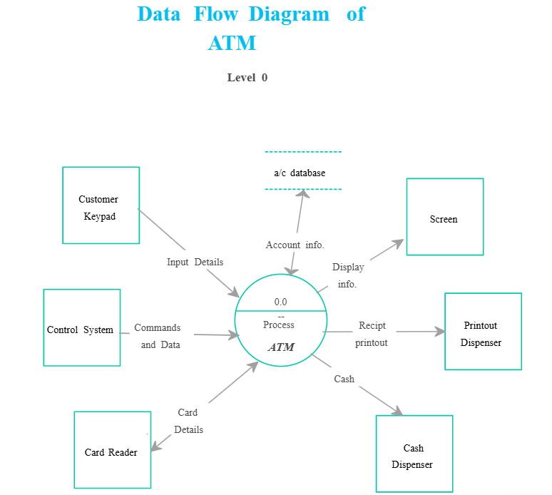
FUNCTION-ORIENTED SOFTWARE
DESIGN

Slide 42
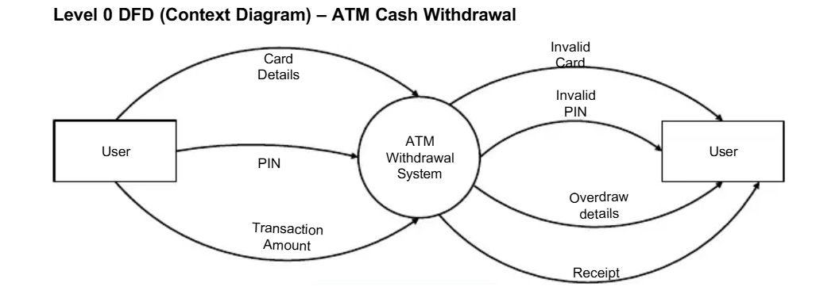
FUNCTION-ORIENTED SOFTWARE
DESIGN

Slide 43
FUNCTION-ORIENTED SOFTWARE
DESIGN
Follow any one !!

Slide 44
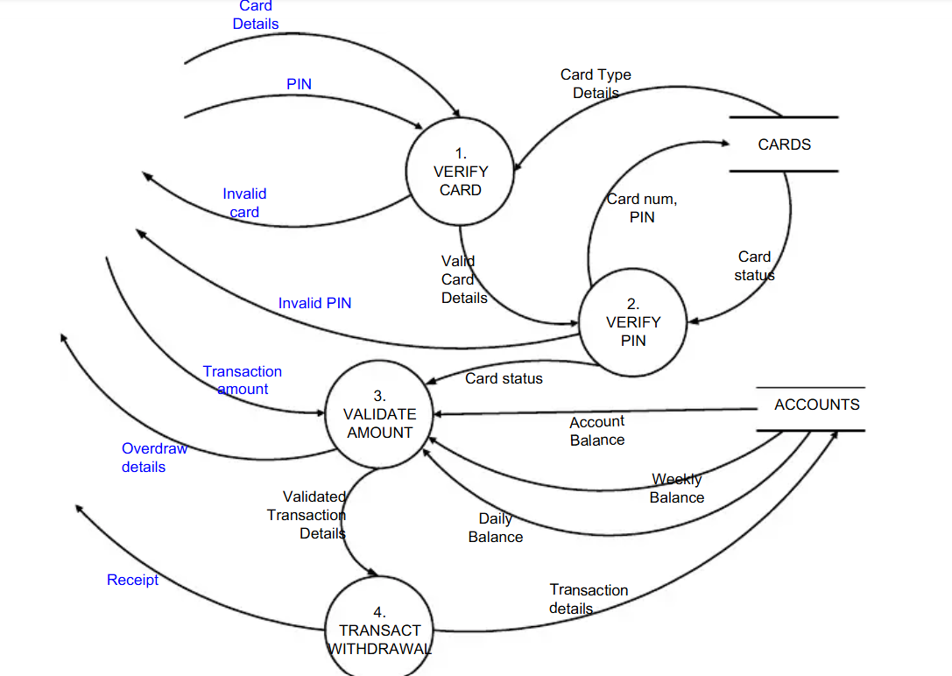
FUNCTION-ORIENTED SOFTWARE
DESIGN

Slide 45
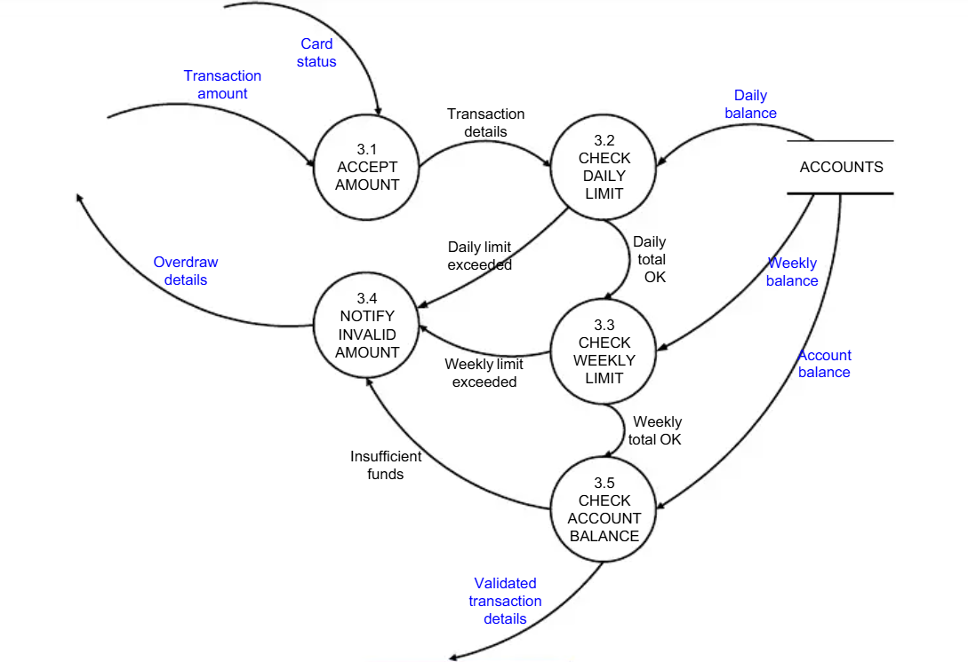
FUNCTION-ORIENTED SOFTWARE
DESIGN

Slide 46
FUNCTION-ORIENTED SOFTWARE
DESIGN
STRUCTURED DESIGN
The aim of structured design is to transform the results of the structured analysis (that i s, the DFD model) into a structure chart.
A structure chart represents the software architecture.
The various modules making up the system, the module dependency (i.e. which module calls which other modules), and the parameters that are passed among the different modules.
The basic building blocks using which structure charts are designed are as following:
Rectangular boxes: A rectangular box represents a module. Usually, every rectangular box is annotated with the name of the module it represents. Module invocation arrows: An arrow connecting two modules implies that during program execution control is passed from one module to the other in the direction of the connecting arrow.

Slide 47
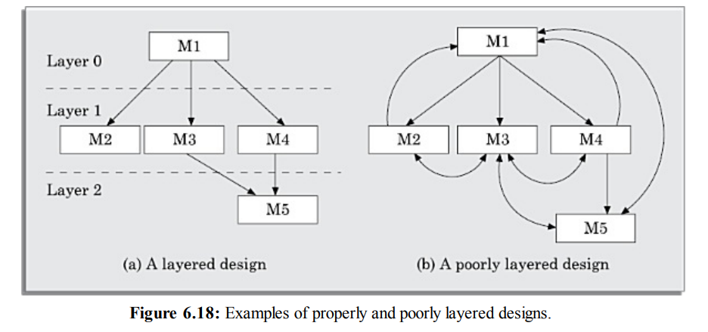
FUNCTION-ORIENTED SOFTWARE
DESIGN
Data flow arrows: The data flow arrows are annotated with the corresponding data name.
Library modules: A library module is usually represented by a rectangle with double edges.
Selection: The diamond symbol represents the fact that one module of several modules connected with the diamond symbol i s invoked

Slide 48
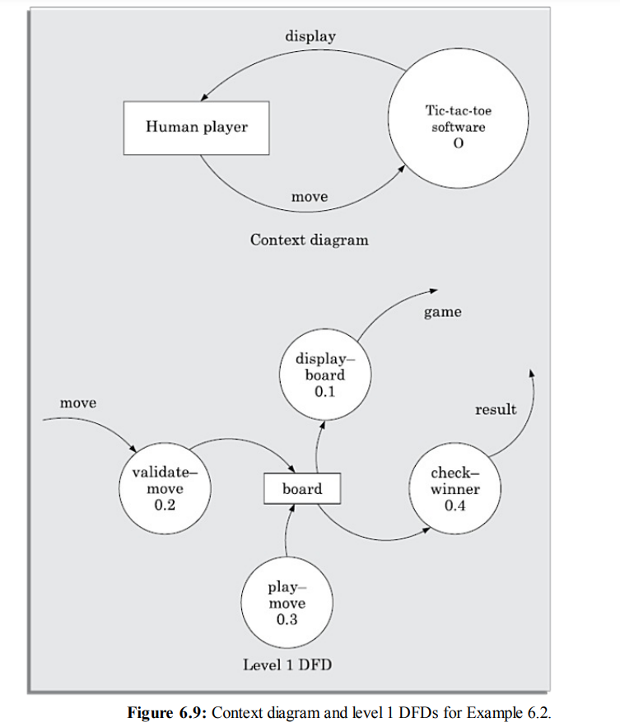
FUNCTION-ORIENTED SOFTWARE
DESIGN
DFD for Tic-Tac-Toe
software

Slide 49
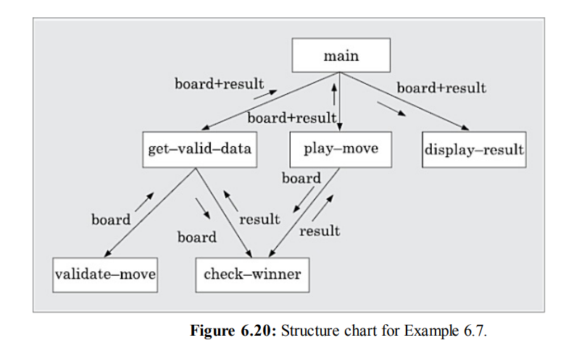
FUNCTION-ORIENTED SOFTWARE DESIGN
Draw the structure chart for the tic-tac-toe software

Slide 50
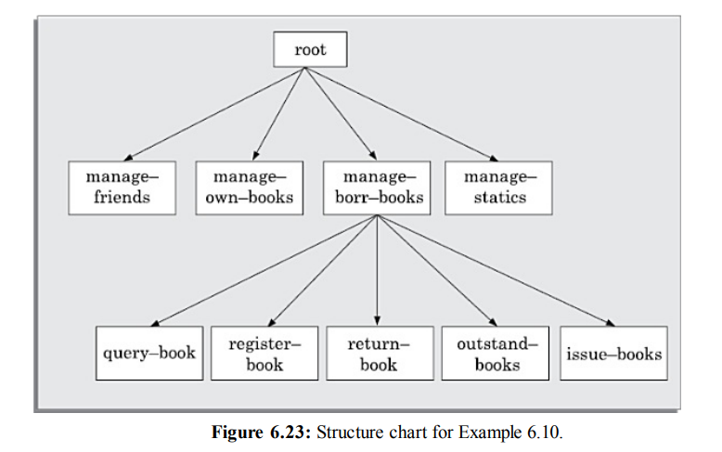
FUNCTION-ORIENTED SOFTWARE DESIGN
Draw the structure chart for the personal library software

Slide 51
FUNCTION-ORIENTED SOFTWARE DESIGN
DETAILED DESIGN
During detailed design the pseudo code description of the processing and the different data structures are designed for the different modules of the structure chart.
Detailed Design are usually described in the form of module specifications (MSPEC). MSPEC is usually written using structured English.
To develop the MSPEC of a module, refer the DFD model and the SRS document to determine the functionality of the module.

Slide 52
FUNCTION-ORIENTED SOFTWARE DESIGN
DESIGN REVIEW
The review team checks the design documents especially for the following aspects:
Traceability: Whether each bubble of the DFD can be traced to some module in the structure chart and vice versa.
Correctness: Whether all the algorithms and data structures of the detailed design are correct.
Maintainability: Whether the design can be easily maintained in future.
Implementation: Whether the design can be easily and efficiently be implemented.

Slide 53
USER INTERFACE DESIGN
The user interface portion of a software product is responsible for all interactions with the user.
Almost every software product has a user interface (can you think of a software product that does not have any user interface?).
The user interface part of a software product is responsible for all interactions with the end-user
Users become particularly irritated when a system behaves in an unexpected ways, i.e., issued commands do not carry out actions according to the intuitive expectations of the user
For many interactive applications, as much as 50 per cent of the total development effort is spent on developing the user interface part.

Slide 54
USER INTERFACE DESIGN
CHARACTERISTICS OF A GOOD USER INTERFACE
1. Speed of learning: A good user interface should be easy to learn.
Besides, the following three issues are crucial to enhance the speed of learning:
Use of metaphors and intuitive command names: Speed of learning an interface is greatly facilitated if these are based on some day-to-day real-life examples or some physical objects with which the users are familiar with.
Consistency: Once, a user learns about a command, he should be able to use the similar commands in different circumstances for carrying out similar actions.
Component-based interface: Users can learn an interface faster if the interaction style of the interface is very similar to the interface of other applications with which the user is already familiar with.

Slide 55
USER INTERFACE DESIGN
CHARACTERISTICS OF A GOOD USER INTERFACE
2. Speed of use: Speed of use of a user interface is determined by the time and user effort necessary to initiate and execute different commands.
3. Speed of recall: Once users learn how to use an interface, the speed with which they can recall the command issue procedure should be maximised.
4. Error prevention: A good user interface should minimise the scope of committing errors while initiating different commands.
5. Aesthetic and attractive: A good user interface should be attractive to use. An attractive user interface catches user attention and fancy.

Slide 56
USER INTERFACE DESIGN
CHARACTERISTICS OF A GOOD USER INTERFACE
6. Consistency: The commands supported by a user interface should be consistent.(Accurate)
7. Feedback: A good user interface must provide feedback to various user actions. Especially, if any user request takes more than few seconds to process, the user should be informed about the state of the processing of his request.
8. Support for multiple skill levels: A good user interface should support multiple levels of sophistication of command issue procedure for different categories of users.

Slide 57
USER INTERFACE DESIGN
CHARACTERISTICS OF A GOOD USER INTERFACE
9. Error recovery (undo facility): While issuing commands, even the expert users can commit errors. Therefore, a good user interface should allow a user to undo a mistake committed by him while using the interface.
10. User guidance and on-line help: Users seek guidance and on-line help when they either forget a command or are unaware of some features of the software.

Slide 58
USER INTERFACE DESIGN
BASIC CONCEPTS
1. User Guidance and On-line Help
* Users may seek help about the operation of the software any time while using the software.
* This is provided by the on-line help system.
* This is different from the guidance and error messages which are flashed automatically without the user asking for them
  On-line help system
  Guidance messages
  Error messages

Slide 59
USER INTERFACE DESIGN
BASIC CONCEPTS
2. Mode-based versus Modeless Interface
A mode is a state or collection of states in which only a subset of all user interaction tasks can be performed.
In a mode-based interface, different sets of commands can be invoked depending on the mode in which the system is, i.e., the mode at any instant is determined by the sequence of commands already issued by the user.
In a modeless interface, the same set of commands can be invoked at any time during the running of the software.
Thus, a modeless interface has only a single mode and all the commands are available all the time during the operation of the software

Slide 60
USER INTERFACE DESIGN
BASIC CONCEPTS
3. Graphical User Interface (GUI) versus Text-based User Interface
In a GUI multiple windows with different information can simultaneously be displayed on the user screen. This is perhaps one of the biggest advantages of GUI over text- based interfaces .
Iconic information representation and symbolic information manipulation is possible in a GUI
A GUI usually supports command selection using an attractive and user-friendly menu selection system
a GUI requires special terminals with graphics capabilities for running and also requires special input devices such a mouse. On the other hand, a text-based user interface can be implemented even on a cheap alphanumeric display terminal.

Slide 61
USER INTERFACE DESIGN
TYPES OF USER INTERFACES
Broadly speaking, user interfaces can be classified into the following three categories:
Command language-based interfaces
Menu-based interfaces
Direct manipulation interfaces

Slide 62
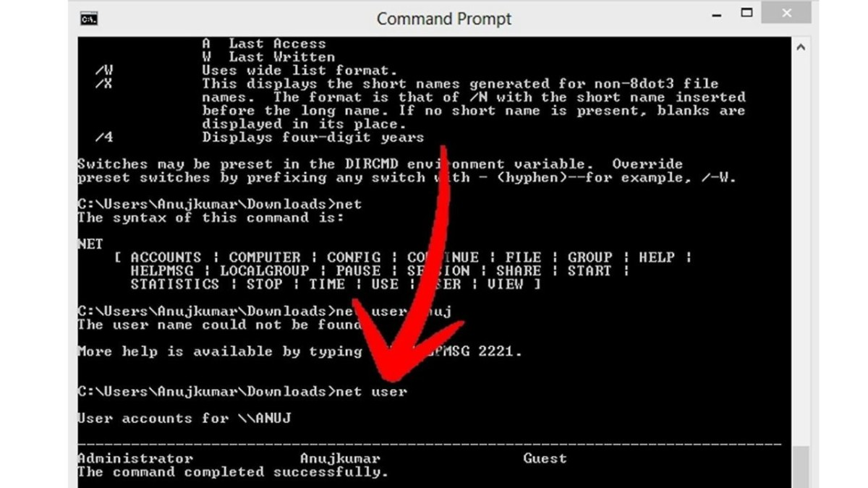
USER INTERFACE DESIGN
TYPES OF USER INTERFACES
1. Command Language-based Interface
A command language-based interface—as the name itself suggests, is based on designing a command language which the user can use to issue the commands.
command language-based interfaces
suffer from several drawbacks. Usually,
command language-based interfaces
are difficult to learn and require the
user to memorize the set of primitive
commands. Also, most users make errors

Slide 63
USER INTERFACE DESIGN
TYPES OF USER INTERFACES
1. Command Language-based Interface
Issues in designing a command language-based interface
The designer has to decide what mnemonics (command names) to use for the different commands. For example, the shortest mnemonic should be assigned to the most frequently used commands
The designer has to decide whether the users will be allowed to redefine the command names to suit their own preferences.(user define his own mnemonics)
The ability to combine commands is a powerful facility in the hands of experienced users, but quite unnecessary for inexperienced users.

Slide 64
USER INTERFACE DESIGN
TYPES OF USER INTERFACES
2. Menu-based Interface
An important advantage of a menu-based interface over a command language-based interface is that a menu-based interface does not require the users to remember the exact syntax of the commands.
A menu-based interface is based on recognition of the command names, rather than recollection.

Slide 65
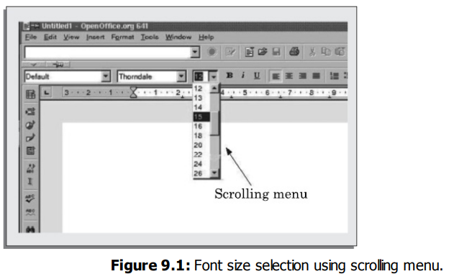
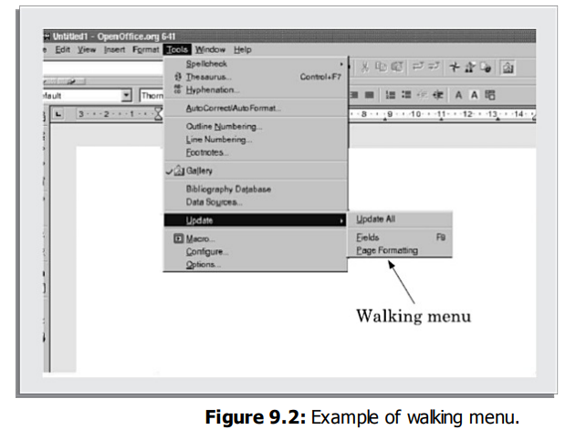
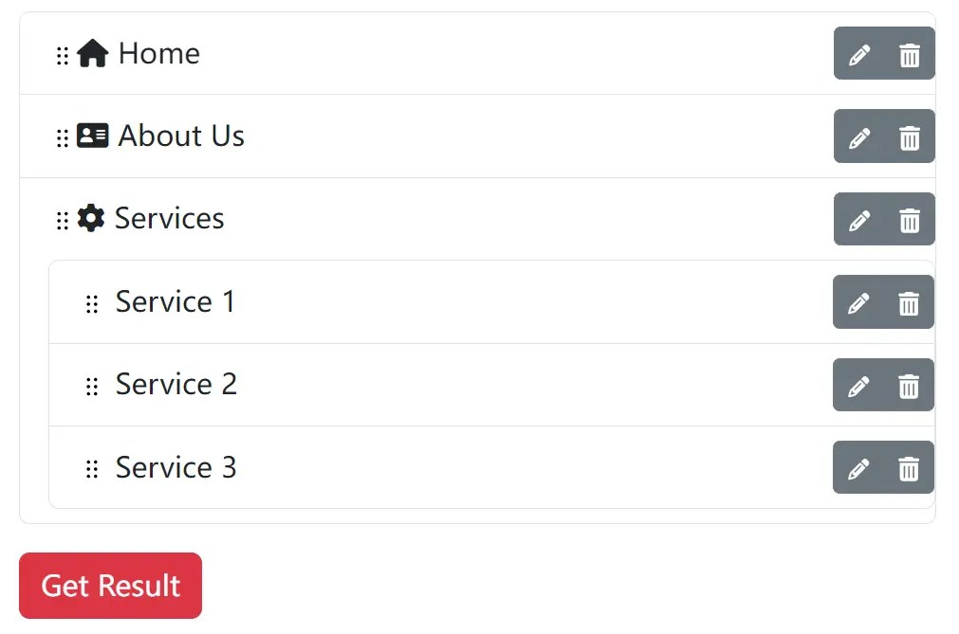
USER INTERFACE DESIGN
TYPES OF USER INTERFACES
2. Menu-based Interface
Scrolling menu Walking menu Hierarchical menu

Slide 66
USER INTERFACE DESIGN
TYPES OF USER INTERFACES
3. Direct Manipulation Interfaces
Direct manipulation interfaces present the interface to the user in the form of visual models (i.e., icons or objects). For this reason, direct manipulation interfaces are sometimes called as iconic interfaces.
For example, if one has to drag an icon representing the file to a trash box icon for deleting a file, then in order to delete all the files in the directory one has to perform this operation individually for all files —which could be very easily done by issuing a command like delete

Slide 67
USER INTERFACE DESIGN
FUNDAMENTALS OF COMPONENT-BASED GUI DEVELOPMENT
The current style of user interface development is component-based. It recognizes that every user interface can easily be built from a handfuls of predefined components such as menus, dialog boxes, forms, etc
An overview of the window management system, the component-based development style, and visual programming

Slide 68
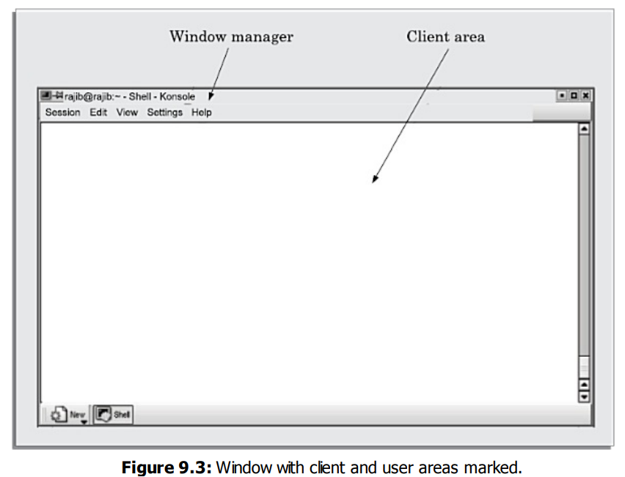
USER INTERFACE DESIGN
FUNDAMENTALS OF COMPONENT-BASED GUI DEVELOPMENT
Window System
Most modern graphical user interfaces are developed using some window system. A window system can generate displays through a set of windows.
Window: A window is a rectangular area on the screen. A window can be considered to be a virtual screen, in the sense that it provides an interface to the user for carrying out independent activities, e.g., one window can be used for editing a program and another for drawing pictures, etc.

Slide 69
USER INTERFACE DESIGN
FUNDAMENTALS OF COMPONENT-BASED GUI DEVELOPMENT
Window management system (WMS)
Most graphical user interface development environments do this through a window management system (WMS).
A window management system is primarily a resource manager. It keeps track of the screen area resource and allocates it to the different windows that seek to use the screen.
A WMS can be considered as a user interface management system (UIMS) —which not only does resource management, but also provides the basic behavior to the windows

Slide 70
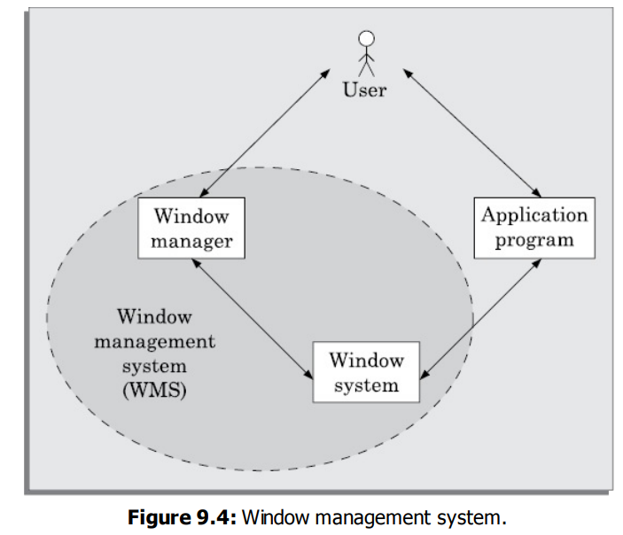
USER INTERFACE DESIGN
FUNDAMENTALS OF COMPONENT-BASED GUI DEVELOPMENT
Window management system (WMS)
A WMS consists of two parts
A window manager, and a window system.
The window manager is built on the top of the window system in the sense that it makes use of various services provided by the window system.
This figure shows that the end-user can either interact with the application itself or with the window manager (resize, move, etc.) and both the application and the window manger invoke services of the window manager.

Slide 71
USER INTERFACE DESIGN
FUNDAMENTALS OF COMPONENT-BASED GUI DEVELOPMENT
Component-based development
A development style based on widgets is called component-based (or widget-based ) GUI development style.
Types of Widgets
Label widget
Container widget
Pop-up menu
Pull-down menu
Dialog boxes
Push button
Radio buttons
Combo boxes

Slide 72
USER INTERFACE DESIGN
FUNDAMENTALS OF COMPONENT-BASED GUI DEVELOPMENT
Visual programming
Visual programming is the drag and drop style of program development.
In this style of user interface development, a number of visual objects (icons) representing the GUI components are provided by the programming environment.
The application programmer can easily develop the user interface by dragging the required component types (e.g., menu, forms, etc.) from the displayed icons and placing them wherever required.

Slide 73
USER INTERFACE DESIGN
A USER INTERFACE DESIGN METHODOLOGY
At present, no step-by-step methodology is available which can be followed to come up with a good user interface.
What we present in this section is a set of recommendations which can use
Implications of Human Cognition Capabilities on User Interface Design
Limited memory
Frequent task closure
Recognition rather than recall

Slide 74
USER INTERFACE DESIGN
A USER INTERFACE DESIGN METHODOLOGY
ii. A GUI Design Methodology
Our user interface design methodology consists of the following important steps:
Examine the use case model of the software. Interview, discuss, and review the GUI issues with the end-users
Task and object modelling.
Metaphor selection.
Interaction design and rough layout.
Detailed presentation and graphics design.
GUI construction.
Usability evaluation.

Slide 75
USER INTERFACE DESIGN
User interface inspection
The following check list has to be inspected
Visibility of the system status
Match between the system and the real world
Undoing mistakes
Consistency
Recognition rather than recall
Support for multiple skill levels
Aesthetic and minimalist design
Help and error messages
Error prevention

